Slide 1
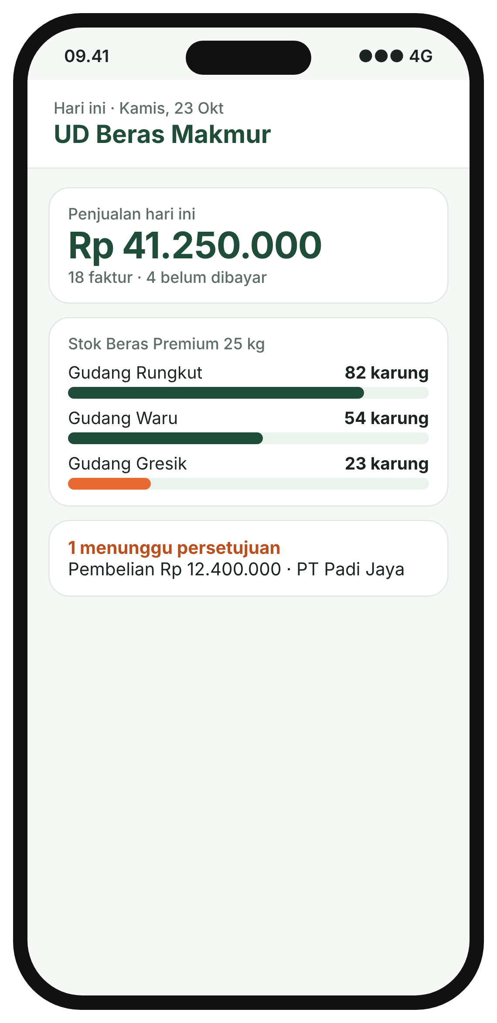
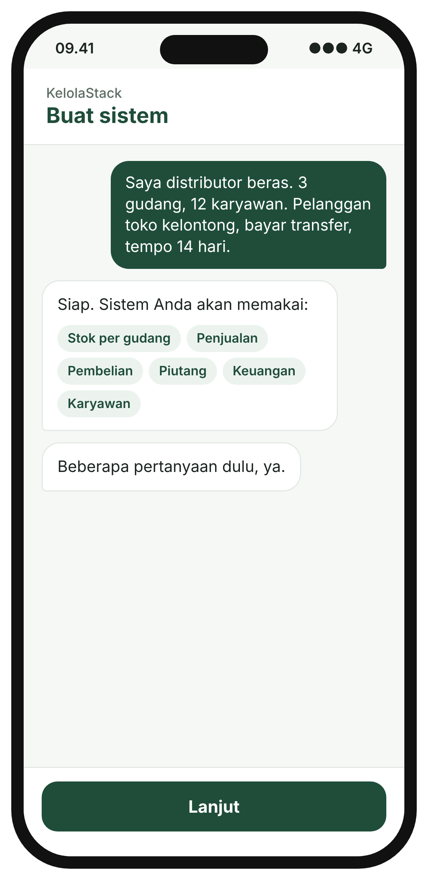
KelolaStack
Your own business system.
Set up by chat.
Stock, sales, money and staff in one app
Amadeus Eugene Dirgantara · Founder
English for Business Proficiency
Notes:
• One-liner first: a business system, set up by chat
• Name, role, course

Slide 2





One order, typed three times
PROBLEM
WhatsApp
Order comes in
90,627
Excel
Rice distributor
Typed again for stock
small and medium businesses in Indonesia
12 staff
3 warehouses
200+ shop customers
Accounting app
Typed again for the books
Mistakes, late stock counts, no daily profit
Notebook
Commission counted by hand
Sample business. Source for the count: GoodStats (2026)
Notes:
• Picture a rice distributor: order arrives on WhatsApp
• Same order typed into Excel, the accounting app, the commission notebook
• Result: typos, stock that doesn't match, owner never sees today's profit
• About 90,627 small and medium businesses like this

Slide 3
A proper system costs a house
PROBLEM
Custom-built system
Rp 200M – Rp 800M
3–6 months
Odoo, set up by a consultant
Rp 50M – Rp 300M
2–4 months
Setup only, before the first monthly fee
Too big for a growing business. Too much for spreadsheets.
Source: Next-IT (2026)
Notes:
• The fix today is an ERP: one system for stock, sales, money, staff
• Setting one up: Rp 50M–Rp 300M with Odoo, Rp 200M–Rp 800M custom-built
• That is setup only, months of consultants
• So these businesses stay on spreadsheets

Slide 4
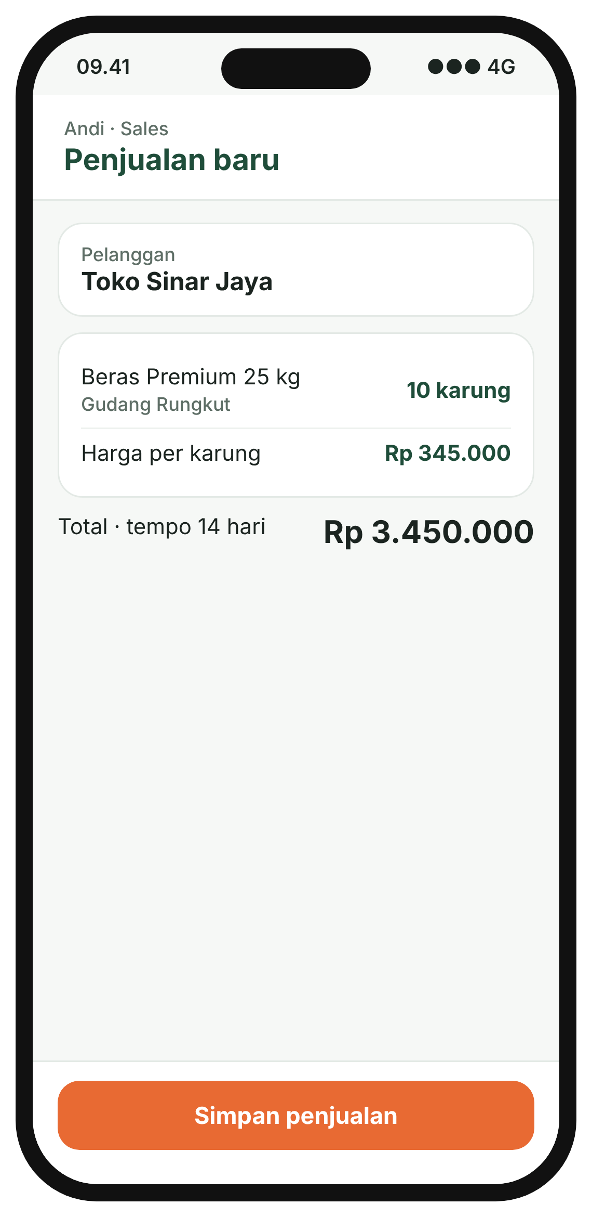



One sale, typed once, updates everything
SOLUTION
Stock
Books
−10 sacks, Rungkut warehouse
+Rp 3,450,000 owed by the shop
Invoice
Commission
Created, due in 14 days
Andi earns Rp 69,000
This is what big companies call ERP
Screens are design mock-ups with a sample business.
Notes:
• Explain ERP by showing it, not defining it
• Salesperson enters one sale on the phone
• Same moment: stock drops, invoice made, books updated, commission counted
• No typing it four times

Slide 5
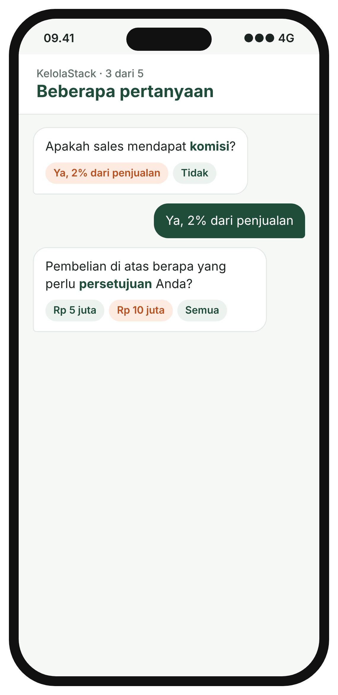
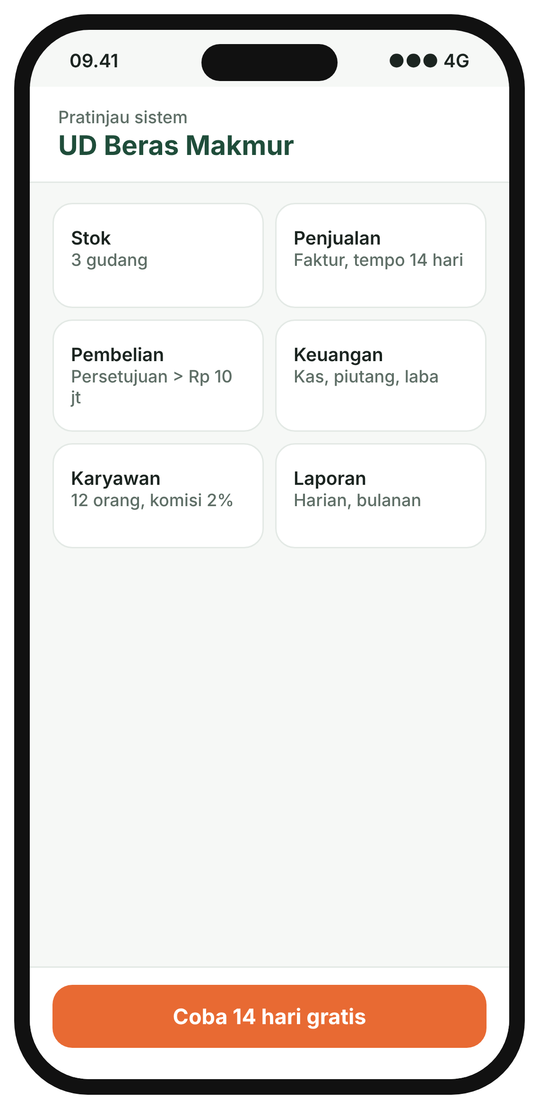
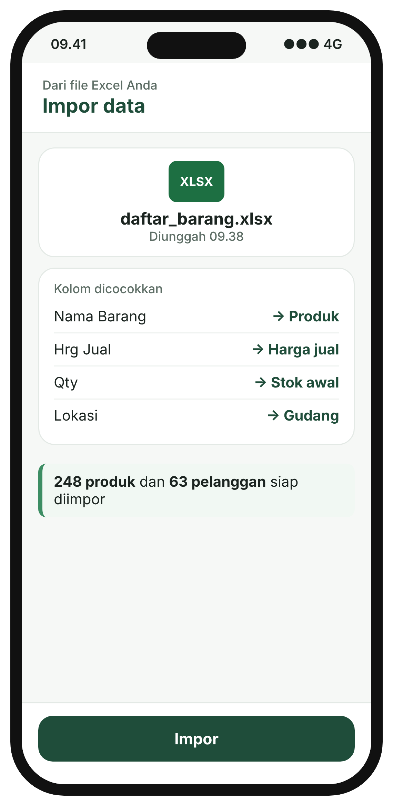
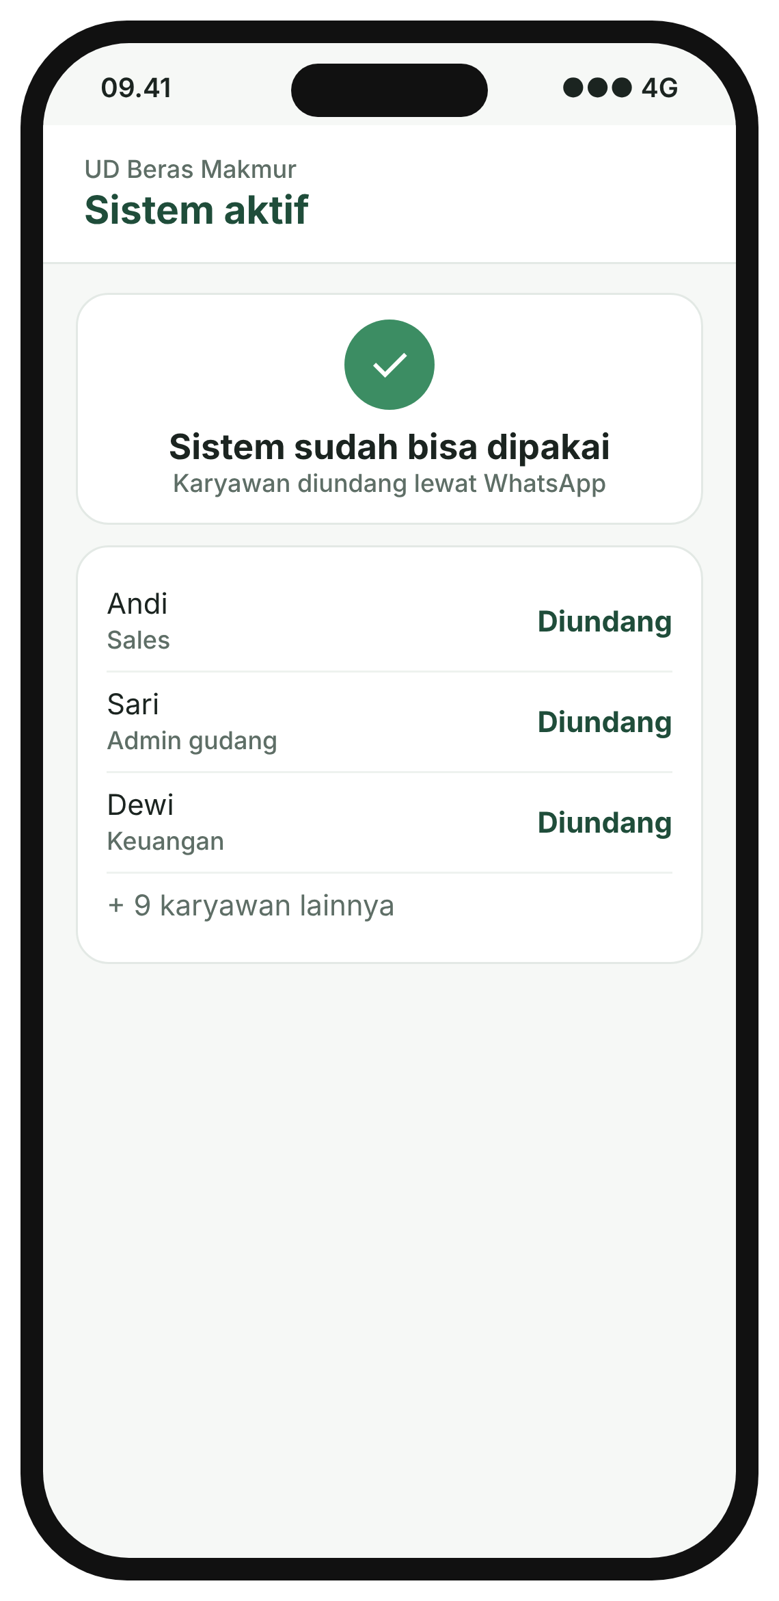
From your phone to a working system, in days
SOLUTION
1
Describe
2
Answer
3
Check
4
Import
5
Go live
Your business, in Bahasa
A few questions
Your system's menus
Your Excel files
Staff log in
Screens are design mock-ups with a sample business.
Notes:
• Walk the five screens left to right
• Owner types how the business works, like telling a new manager
• App asks a few questions, shows the system, pulls in the old Excel
• Tap publish, staff get a WhatsApp invite
• No consultant, no setup fee, days not months

Slide 6
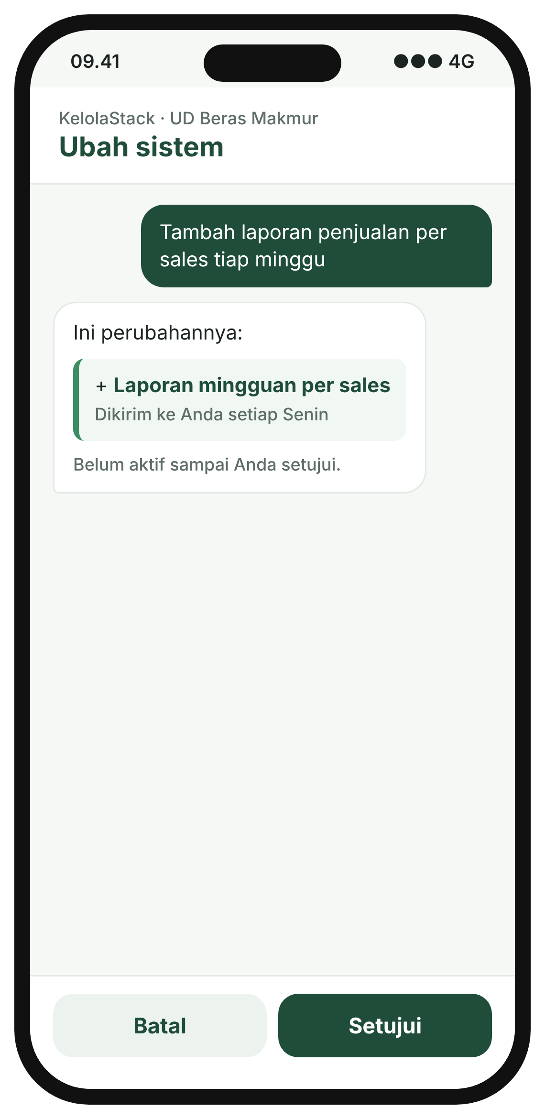
Ready-made parts, arranged for you
SOLUTION
Stock
Sales
Purchasing
The AI never
Does the maths on your money
Finance
Staff
Approvals
Touches your bank account
Built and tested once. The AI picks and sets them up.
Changes anything without your OK
Screens are design mock-ups with a sample business.
Notes:
• Analogy: a tailor with pre-cut panels. Custom fit, but every panel already tested
• The AI only chooses and arranges the parts
• Money maths is normal tested code, so an AI mistake can't break the books
• Later changes by chat, owner taps approve

Slide 7



Growing businesses, 5 to 50 staff
CUSTOMERS
Pays: the owner
Distributors, makers, shops, food businesses
Uses: their staff
Sales, warehouse, finance, on their own phones
Later: accountants
Set it up for their clients, Year 3
Not us
One-person stalls, big companies
Screens are design mock-ups with a sample business.
Notes:
• Customer = owner who pays. Users = staff
• Big enough to feel the mess, too small for a Rp 300M system
• Stalls only need a cashier app. Big companies already have SAP

Slide 8
The market, counted low
MARKET
Rp 433.9B
TAM
+8.6%
90,627 small and medium businesses
SAM
Rp 86.1B
a year, business software in Indonesia
17,989 already using a finance app
SOM
31%
Rp 565.0M
of it is ERP, the biggest part
118 paying by Year 3
Counted at the Usaha plan, Rp 4,788,000 a year. Sources: GoodStats (2026); Kartikasari et al. (2022); Mordor Intelligence (2026)
Notes:
• TAM: all small and medium businesses. SAM: only those already on a finance app
• SOM: 118 paying, 0.7% of SAM
• Valued at the cheaper plan, on purpose
• Market grows 8.62% a year, ERP is the biggest slice

Slide 9
Monthly plan, no setup fee
BUSINESS MODEL
Trial
Usaha
Bisnis
Free
Rp 399,000
Rp 1,199,000
14 days with your own data
a month · up to 5 staff · 75% margin
a month · up to 20 staff, 5 locations · 76% margin
Priced per business, not per user. Later: accountants resell it to their clients.
Prices exclude PPN. Margins assume full use of the AI allowance.
Notes:
• Now: monthly subscription, two plans, free trial
• One price for the whole business, not per staff member
• Later: accountants set it up for clients
• AI cost stays about a fifth of the price

Slide 10
Cheaper than what they'd buy today
BUSINESS MODEL
Rp 0
setup fee
Rp 50M+
Odoo setup
Sources: Accurate (2025); OEC.sh (2026); Majoo (2026). Odoo excludes its setup cost.
Notes:
• Same business, three comparisons
• 20 staff on Odoo: Rp 2.2M a month, plus Rp 50M or more to set up
• 5 outlets on Majoo: Rp 5.0M. On Bisnis: Rp 1.2M
• Accurate covers accounting only

Slide 11



Prove it with 10 businesses first
PLAN
1
2
3
4
5
6
Months 1–3
Month 3
Months 4–6
Year 1
Year 2
Year 3
Pilot: 10 SMEs
3 of 10 pay, or stop
Test ads at Rp 3M/month
28 paying
72 paying
118 + accountants
Search ads
Demos in person
Referrals
Notes:
• Traction today: research and a pilot plan, no revenue yet. Say it plainly
• Pilot: 10 businesses in Surabaya, free for 3 months
• Gate: if fewer than 3 agree to pay, stop and return unspent money
• Ads raised to Rp 8M a month only after the test
• Targets are net of cancellations

Slide 12
Loss for two years, profit in Year 3
PLAN
Rp 130.9M
lowest cash, month 18
75%
kept from each plan after AI and hosting
Assumes Rp 4.8M of ads per paying customer, one admin per 30 customers, 2% cancel a month, no founder salary
Notes:
• Three numbers only
• Year 3 revenue Rp 748.2M, net Rp 143.1M
• Cash lowest at Rp 130.9M in month 18, then subscriptions cover everything
• Costs assumed on the pessimistic side

Slide 13



A founder who writes the code
TEAM
Building software since 2019
The gap, and the fix
Freelance apps for clients abroad
Selling to businesses
No sales experience yet
Hires from month 4
Full-time admins for setup and support, one per 30 customers
Intern, Fiesto Informatika
Client websites and apps
Informatics, Universitas Ciputra
Fifth semester, AI focus
Notes:
• Founder builds it, so money goes to customers, not developers
• Weakness first: no experience selling to businesses
• Pilot tests that
• Admins join from month 4 to help customers set up

Slide 14
The ask
Rp 150M for 20%
Paid once. Unspent money returned if the pilot fails.
Return
Runway
Where it goes
3.2×
Month 18
Ads + admins
your 20% at 3.2× Year 3 revenue
covers the Rp 130.9M low point
Rp 105M ads, Rp 111M admins, Rp 115M AI, Rp 45M running costs
Spending to month 18, less Rp 245M of subscriptions. Multiple: public SaaS 2026 low 3.2×, median 4.6× (Aventis Advisors, 2026)
Notes:
• Why now: business software growing, setup still costs hundreds of millions
• Why me: I build it, so the money goes to customers
• Return: Year 3 revenue Rp 748.2M × 3.2 = Rp 2.4B, your 20% is Rp 478.8M
• Used the 2026 low multiple, not the median

Slide 15
Every growing business deserves a proper system.
Now it costs Rp 399k a month, not Rp 300M.
KelolaStack · Questions?
Notes:
• Signal the end
• One line: messy spreadsheets, systems cost a house, KelolaStack sets one up by chat
• Restate the ask, then questions

Slide 16
Backup: risks and terms
BACKUP
AI sets up a faulty system
Tested parts do the maths
Key terms
Registered as a PT with the investor
Single payment on signing
Quarterly reports
Right to join later rounds
Founder stays 3 years, no competing business
AI prices rise
AI is about 21% of each plan
Customers cost more to win
Ads stay at Rp 3M/month until measured
Owners won't pay
Stop after the pilot, return the rest
Notes:
• Only for Q&A
• Full terms in Section VIII of the proposal

Slide 17
References
BACKUP
Accurate. (2025, December 3). Informasi harga paket dasar Accurate 2026.
Aventis Advisors. (2026). SaaS valuation multiples: 2015–2026.
GoodStats. (2026, July 24). Dari 30,2 juta UMKM pada 2025, 99,7% masuk klasifikasi mikro.
JawaPos. (2025, December 25). Resmi, ini daftar UMK 38 kabupaten/kota di Jawa Timur 2026.
Kartikasari, N., Waskito, I., & Indriani, E. (2022). Digitalisasi pelaporan keuangan perspektif UMKM di Kota Mataram.
Majoo. (2026). Harga. Mekari Jurnal. (2026). Harga.
Mordor Intelligence. (2026). Indonesia digital software solutions market size and share analysis.
Next-IT. (2026, August 8). Custom ERP vs SAP vs Odoo: Mana yang cocok untuk perusahaan Indonesia?
OEC.sh. (2026, October 18). Odoo pricing in Indonesia.
Emergent. (2026). Pricing. Intelligent CIO. (2026, January 26). Emergent raises US$70m Series B.
VKTR. (2026). Vibe-coding platform Lovable raises $400 million at $13.3 billion valuation.
Full links are in the business proposal.

