Slide 1
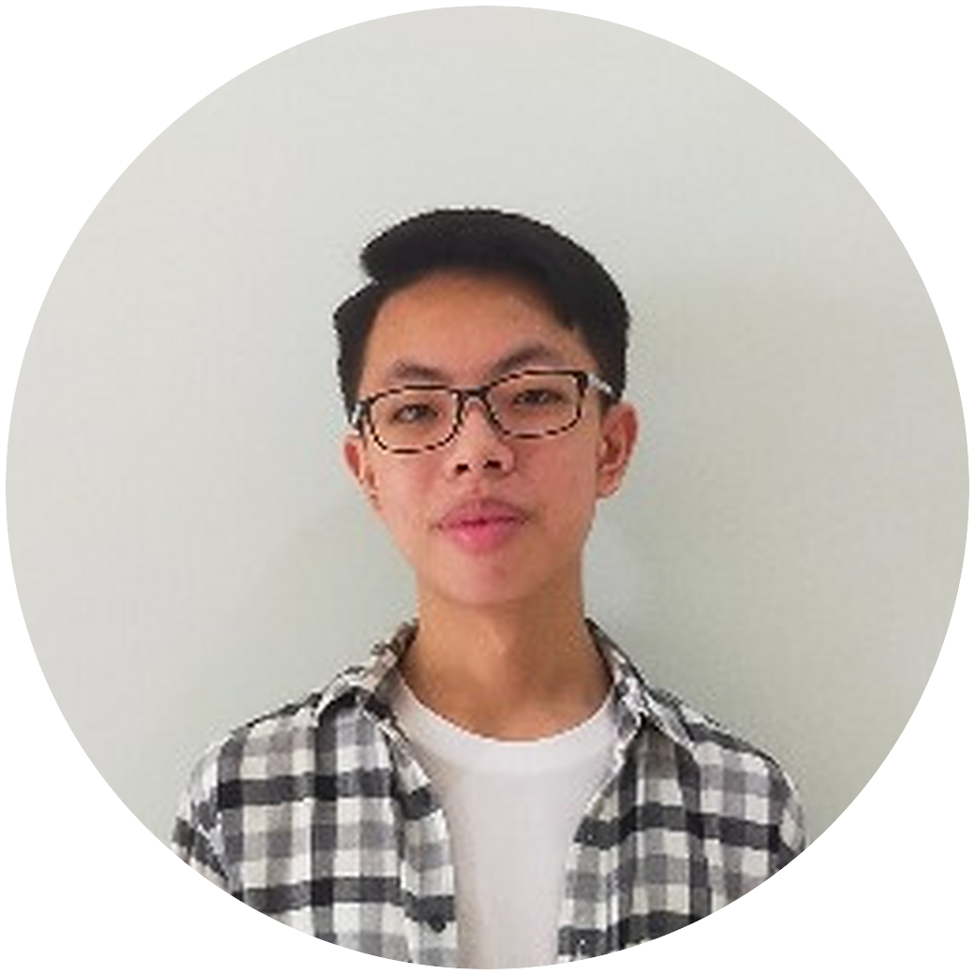
Amadeus
Eugene
Dirgantara
Informatics student, IMT-AI
Universitas Ciputra, Surabaya
Notes:
START. Jump start: an enrolment question.
'Good morning.'
'Who here has used an app, whether that is on a phone or on a laptop?' Pause for two seconds.
'Okay, that was rhetorical, and a stupid question. Obviously everyone here has used an app before.'
'We live in a time when almost no one can live without a phone, and someone has to build those apps.'
'My name is Eugene. I am a fifth-semester Informatics student at Universitas Ciputra, and my focus is AI.'
'I am here to introduce myself.'
'By the end, you will know who I am and what kind of work I do.'

Slide 2
Background
Recent projects
Plans
Notes:
START. The three points, then the first signpost.
'I will be covering three points in this introduction: the first one is my background, then my recent projects, and lastly, my plans.'
'Let me start with my first point, which is my background.'

Slide 3
Freelance
Apps and websites on Fiverr, for clients abroad
Festival ticketing site
Ticket booking for my high school's arts festival
Internship at Fiesto Informatika
Client websites and applications, Surabaya
Problem setter at NPLC
Universitas Ciputra's programming competition
Notes:
POINT 1. One line at a time, top to bottom.
'I started learning to code in junior high school, around 2019, and I have continued since then.'
'From 2019 to 2023 I did freelance projects online. Does anyone here know Fiverr? Ever heard of it?'
'Fiverr is basically like a Tokopedia for services. I posted my service there, and people came to me to solve specific problems in their code.'
'I mostly did apps and websites, for clients in other countries.'
'In 2024 I built a ticketing website for my high school's arts festival. My high school has an annual festival where the grade 12 students perform a musical drama, and we invite people to come and watch.'
'My website let people book their tickets, the way you book cinema tickets on M-Tix.'
'In April 2024 I did an internship at Fiesto Informatika in Surabaya. For four weeks I worked with the team on client websites and applications.'
'At university, I wrote and tested competitive programming problems for NPLC, the National Programming and Logic Competition, which is Universitas Ciputra's own programming competition.'
Signpost: 'That is how I got started. Moving on to my second point, my recent projects.'

Slide 4
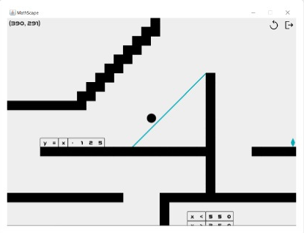
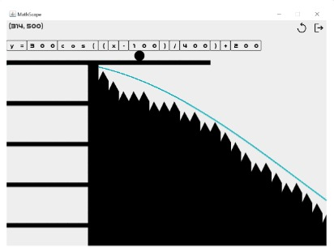
Notes:
POINT 2, project 1.
'These are from my time at university. I work on different kinds of software, so I will show four examples.'
'This is MathScape. MathScape is a single-player platformer game that I made in my first semester, for my final project in the Algorithm and Programming course.'
'The objective is to escape the room by reaching the gem on the right side of the screen.'
'You jump around the blocks, and you move the equation blocks to create a mathematical equation. The game draws that equation as a line that you can step on.'
'In the first image, you can see y equals x minus 125. The game draws the line, and you jump on it to reach the exit. The other level works the same way, but it is harder.' Point at the blue line.

Slide 5
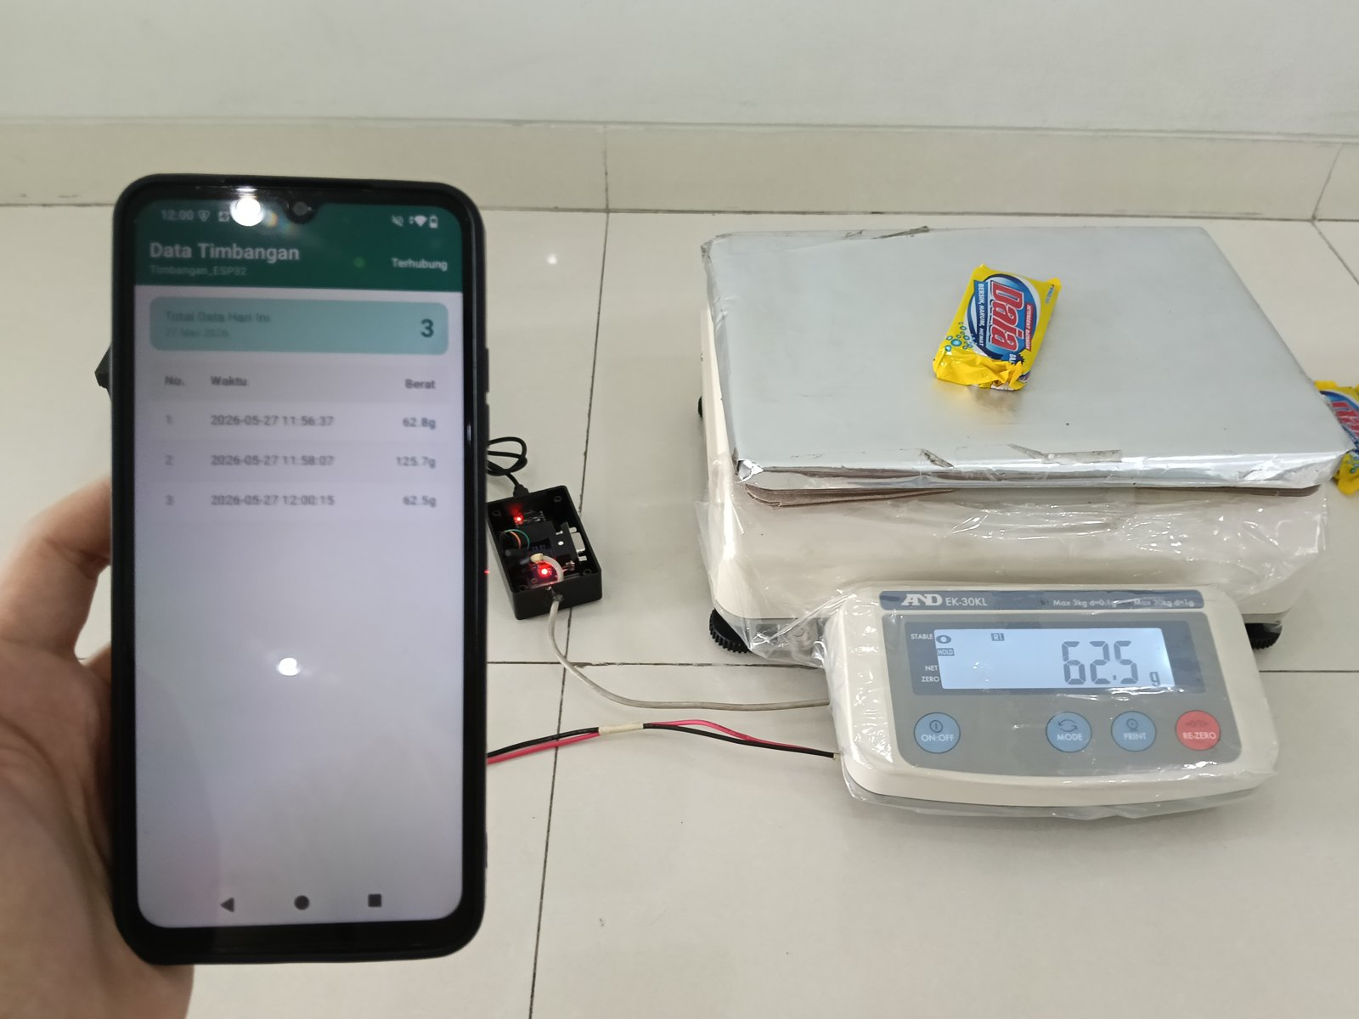
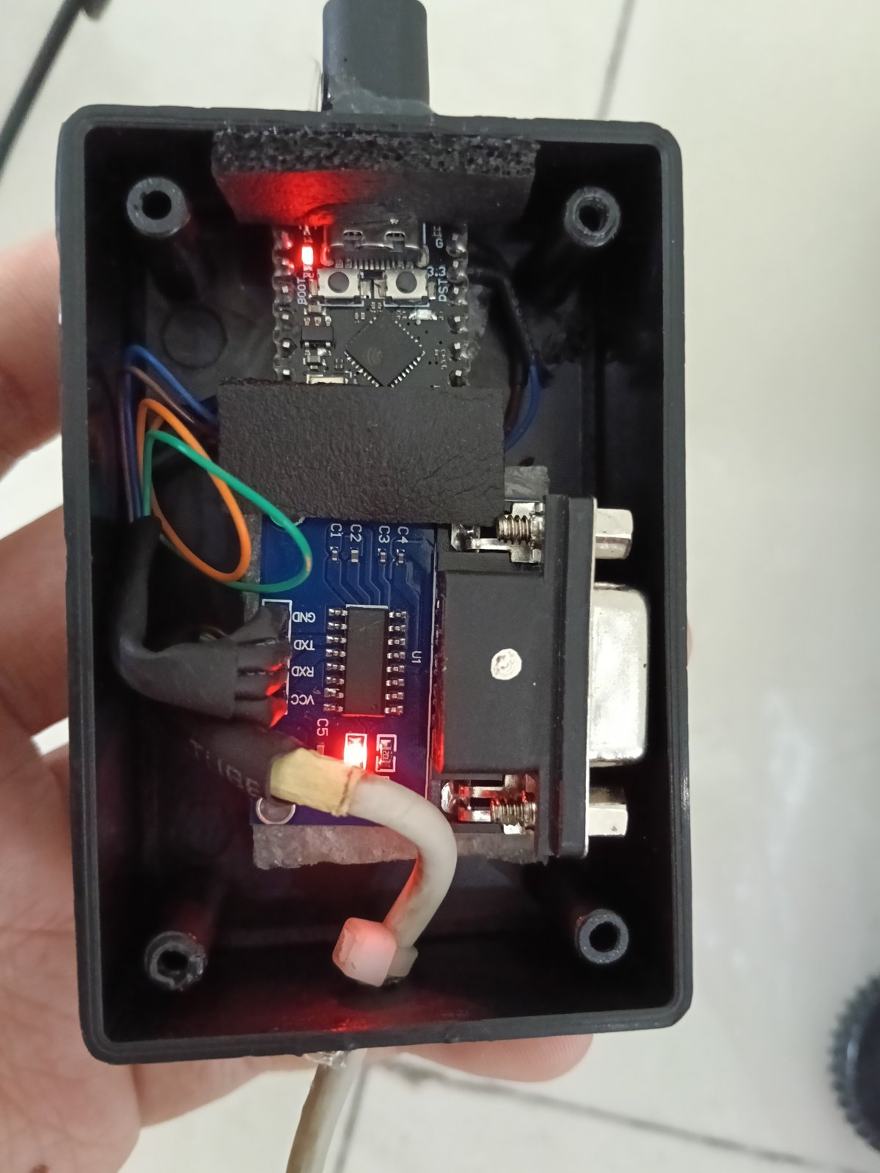
Notes:
POINT 2, project 2.
'The second project is a weighing data logger, a freelance job from this year.'
'Typically, an industrial scale is either read manually or connected to a computer through a wire. If you have twenty scales, you need twenty computers, and that is expensive.'
'So I made a small Bluetooth device. It connects to the scale, receives the weight, and sends it to your phone, as you can see in the left image.'
'The right image is the inside of the device. The client uses it now.'

Slide 6
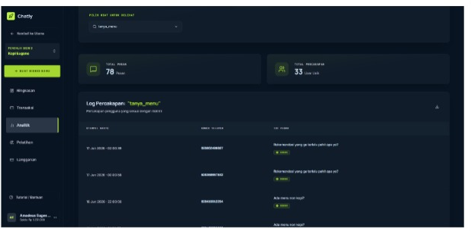
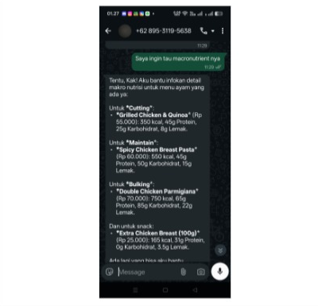
Notes:
POINT 2, project 3.
'The third one is Chatly, a project from the EI class earlier this year.'
'Chatly is a service that provides AI chatbots for customer service.'
'Say you have a business, and your customer service struggles to stay available, or keeps getting the same questions from customers. You can connect a WhatsApp number to Chatly, and Chatly will respond on its own.'
'You tell Chatly what to do. You give it procedures and information about the business, like the FAQ. It learns from that, and it responds to your customers.'

Slide 7
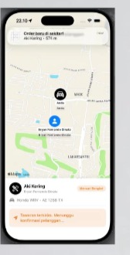
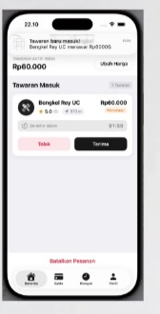
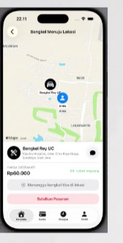
Notes:
POINT 2, project 4, then how you work.
'The last project I am going to show is called Bengkelin. This was also a class project.'
'It is basically inDrive for car workshops. Has anyone here used inDrive? Then you are familiar with ordering and bidding.'
'When you are stranded on a random street with a flat tire, you often do not know who to call. With Bengkelin, you make an order, and you see offers from nearby workshops that are willing to fix your problem for a price.'
'When you accept an offer, they come to your place and fix it for you.'
'It is not only for flat tires. It also covers dead batteries, running out of fuel, and other common problems you can have on the road.'
'Each of these needed something I had not used before, so I learned it. I plan the structure first, and then I work step by step.'
Signpost: 'That brings me to the last point of my presentation: my plans.'

Slide 8
Informatics, IMT-AI
Fifth semester, Universitas Ciputra
Apple Developer Academy
2027 cohort, from my sixth semester
Software or AI engineer
Software that adds value to society
Notes:
POINT 3.
'Right now I am still studying. I am in the fifth semester, and I am still learning a lot from my major's focus, which is AI.'
'My next step is the Apple Developer Academy. I have been accepted for the 2027 cohort, and I will start in my sixth semester.'
'My goal is to work as a software engineer, an AI engineer, or anything close to that.'
'I want to create meaningful software that adds value to society.'

Slide 9
Thank you.
amadeuseugenedirgantara@gmail.com
linkedin.com/in/amadeus-dirgantara-364aa2385
Notes:
FINISH. Go back to the opening question, then ask a new one.
'Before I finish, let me go back to my first question. I asked who here has used an app, and everyone had.'
'So here is a better question. Who here has ever had an idea for an app?' Raise your own hand. Look around for two seconds.
'Keep that idea. If you ever want it built, you know who to ask.'
'My name is Eugene, and I build software. Thank you for listening.'
'Do you have any questions?'

