Slide 1
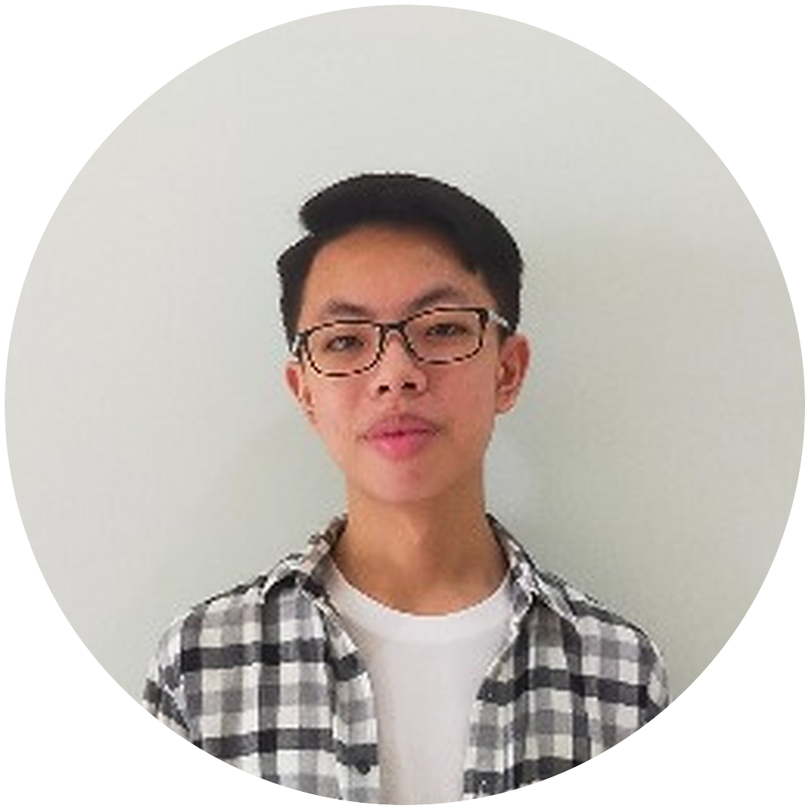
SELF-INTRODUCTION · OCTOBER 2026
Amadeus
Eugene
Dirgantara
Informatics student, AI focus
Universitas Ciputra, Surabaya
Notes:
START. Jump start: Meet the people. Then Who and Why.
Smile. 'Good morning, everyone. Thank you for being here.'
'My name is Amadeus Eugene Dirgantara. I am a fifth-semester Informatics student at Universitas Ciputra, and my focus is AI.'
'I am here to introduce myself.'
'By the end, you will know who I am and what kind of work I do.'

Slide 2
AMADEUS EUGENE DIRGANTARA
SELF-INTRODUCTION
02 / 10
01
Background
02
Projects
03
Plans
Notes:
START. What and How, then the first signpost.
'I will cover three points: my background, some things I have built, and my plans.'
'This will take about six minutes. Please keep your questions until the end.'
'Let me start with my first point, my background.'

Slide 3
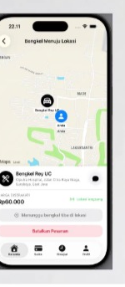
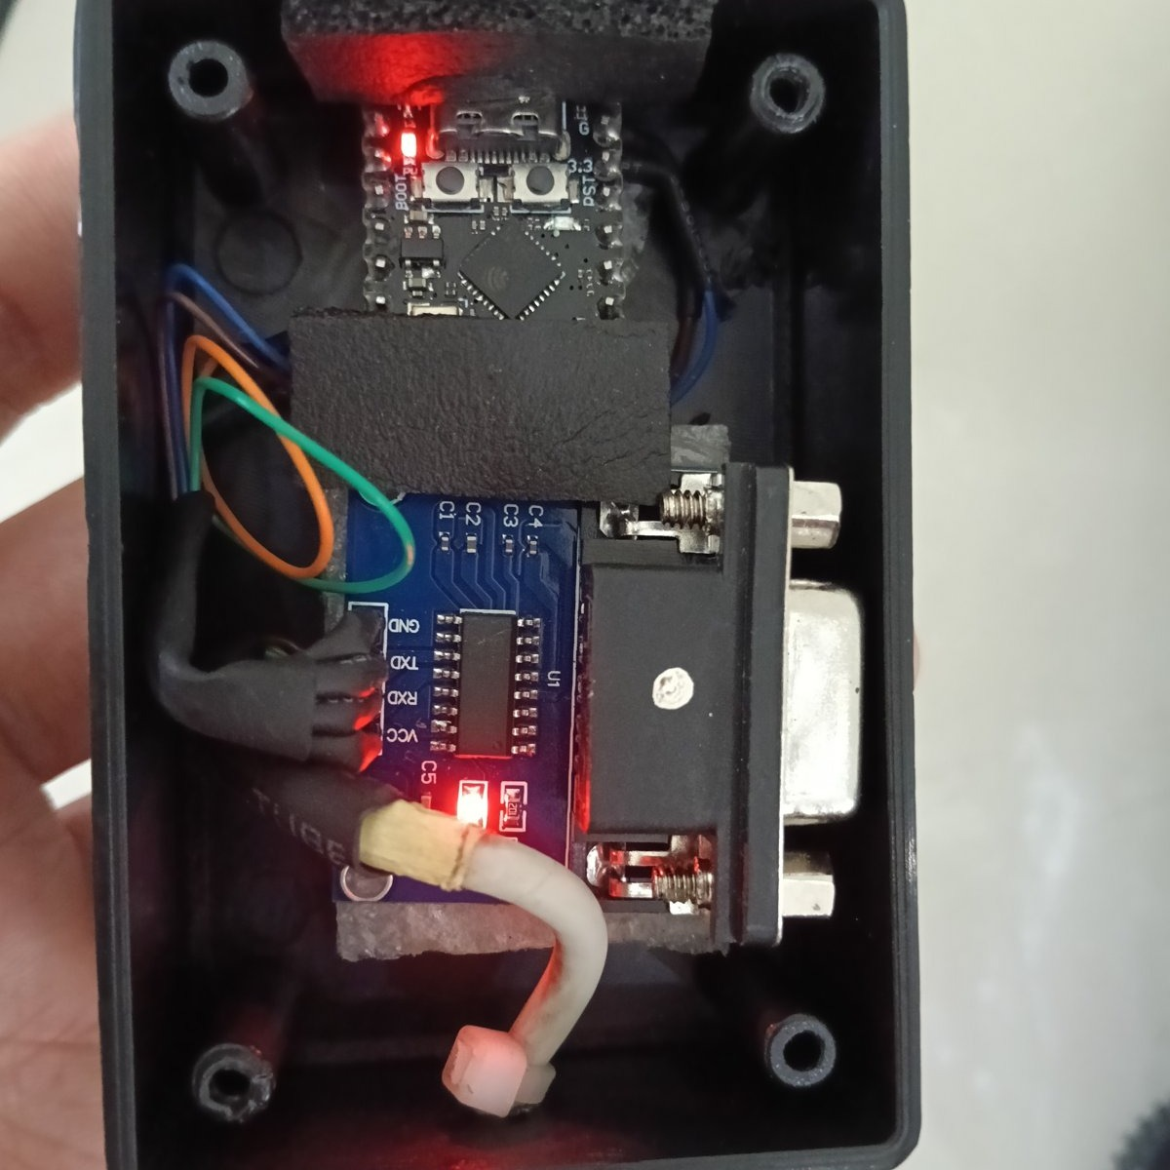
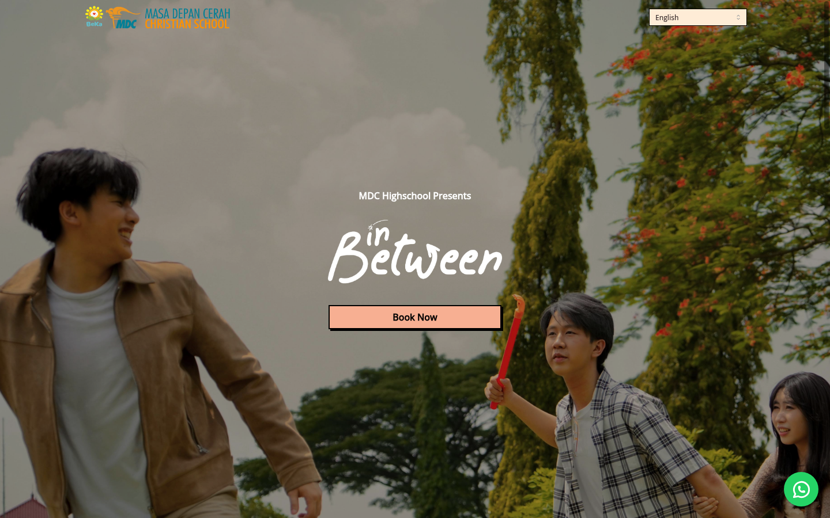
AMADEUS EUGENE DIRGANTARA
BACKGROUND
03 / 10
Software
WEB
MOBILE
DEVICES
Notes:
POINT 1, definition.
'I work in software. That means I build programs that people use, such as websites, phone apps and small devices.'

Slide 4
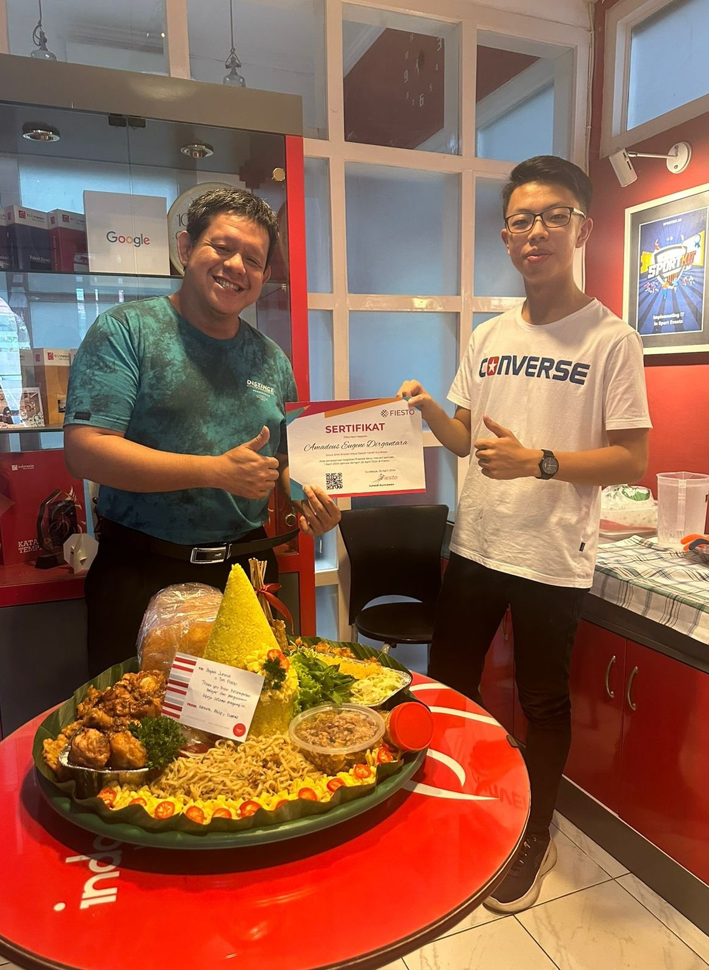
AMADEUS EUGENE DIRGANTARA
BACKGROUND
04 / 10
2019 – 2023
Freelance
2024
Festival ticketing site
April 2024
Internship · Fiesto Informatika
2024 – 2025
Problem setter · NPLC
Notes:
POINT 1, examples and facts. One line at a time, top to bottom. The photo is the last day of the internship.
'I started in junior high school. From 2019 to 2023 I did freelance projects online, mostly apps and websites, for clients in other countries.'
'In 2024 I built the ticketing website for my high school's arts festival. It showed which seats were free and recorded the orders. It was used to sell tickets during the event.'
'In April 2024 I did an internship at Fiesto Informatika in Surabaya. For four weeks I worked with the team on client websites.'
'At university, I wrote and tested problems for NPLC, a programming competition, in 2024 and 2025.'
Signpost: 'Moving on to my second point: some things I have built.'

Slide 5
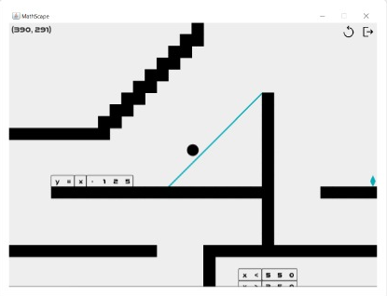
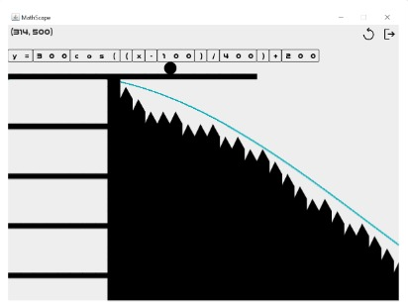
AMADEUS EUGENE DIRGANTARA
PROJECTS
05 / 10
MathScape
2025 · game · course project
A STRAIGHT LINE
A COSINE CURVE
Notes:
POINT 2, definition, then example 1.
'I work on different kinds of software. I will show four examples.'
'The first is MathScape, a game I made in my first semester. The player writes a math equation, and its graph becomes the ground to walk on. It has ten levels.'
'You can see two of them on the screen.' Point at the blue line in each picture.

Slide 6
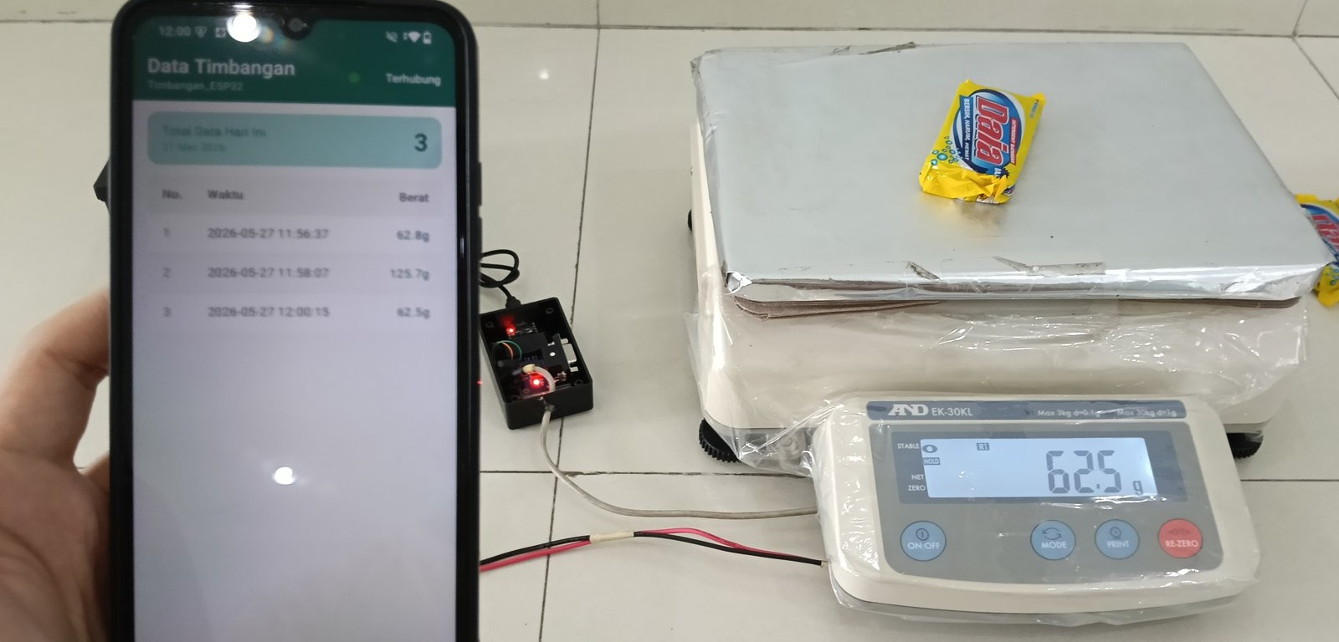
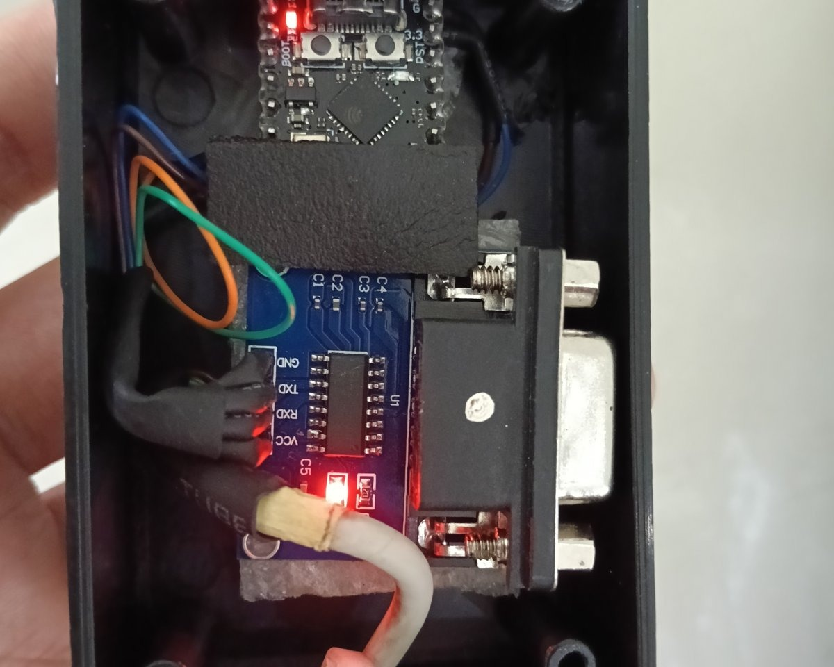
AMADEUS EUGENE DIRGANTARA
PROJECTS
06 / 10
Weighing data logger
2026 · device + Android app · freelance
SCALE → DEVICE → PHONE
INSIDE
Notes:
POINT 2, example 2.
'The second is a weighing data logger, a freelance job from this year. The client weighs goods outdoors with an industrial scale. The scale's own logger saves to a memory card, so someone has to carry the card to a computer.'
'I built a small device that sends each weight to a phone, and an app that saves it to a file. I tested it on the real scale, and the client uses it now.'
'On the left, you can see the scale, the device and the phone. On the right is the inside of the device.' Point as you say each one.
Optional (W3, the prop): if you still have a unit, hold it up here. Just show it. No reveal.

Slide 7
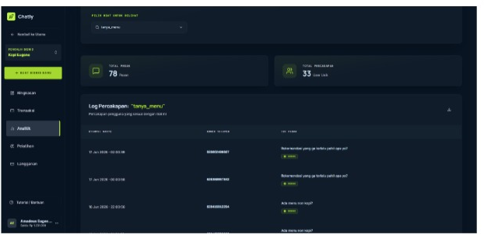
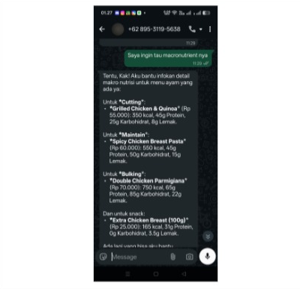
AMADEUS EUGENE DIRGANTARA
PROJECTS
07 / 10
Chatly
2026 · WhatsApp chatbot · team of 8
OWNER
CUSTOMER
Notes:
POINT 2, example 3.
'The third is Chatly, a class project from this year. We were a team of eight, and I was one of two developers. It is a chatbot inside WhatsApp. A business uploads what it sells, and the bot answers its customers.'
'On the left is what the business owner sees. On the right is a real chat with a customer.'

Slide 8
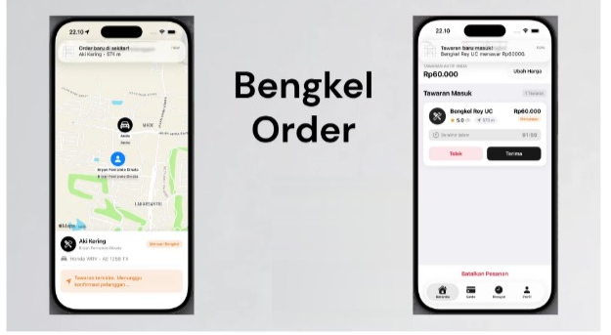
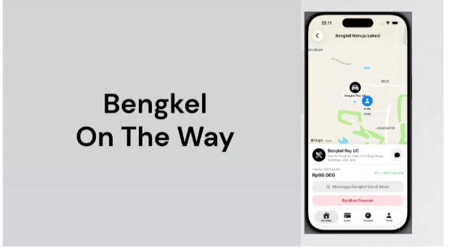
AMADEUS EUGENE DIRGANTARA
PROJECTS
08 / 10
Bengkelin
2026 · iPhone app · team of 4
REQUEST
ON THE WAY
Notes:
POINT 2, example 4, then how you work.
'The fourth is Bengkelin, also a class project, in a team of four. I built the iPhone app. A driver whose car has broken down sends a request, nearby workshops offer a price, and the driver chooses one.'
'On the left, the driver sends a request. On the right, the workshop is on the way.'
'Each of these needed something I had not used before, so I learned it. I plan the structure first, and then I work step by step.'
Signpost: 'That brings me to the last point of my presentation: my plans.'

Slide 9
AMADEUS EUGENE DIRGANTARA
PLANS
09 / 10
Plans
NOW
NEXT
GOAL
Informatics, AI focus
Apple Developer Academy, 2027
Software engineer
Notes:
POINT 3: definition, fact, example. The one question you answer yourself is the lecturer's Question and Answer technique (W2), said in a normal voice.
'My goal is to work as a software engineer. What does that mean? It means building software as my job, as part of a team.'
'Right now I am still studying, and my focus is AI.'
'My next step is the Apple Developer Academy. I will join it in 2027.'
'It is an internship program by Apple that trains app developers.'

Slide 10
AMADEUS EUGENE DIRGANTARA
SUMMARY
10 / 10
2019
4
2027
first projects
kinds of software
Apple Developer Academy
Thank you.
amadeuseugenedirgantara@gmail.com
linkedin.com/in/amadeus-dirgantara-364aa2385
Notes:
FINISH (W1): signal, summary, conclusion, closing remarks. The bang (W3) is the calm kind: you return to what you promised at the start.
Signal: 'To finish, let me summarize.'
Summary: 'First, I have worked in software since junior high school.'
'Second, I have built different kinds of software: a game, a device, a chatbot and a phone app.'
'Third, I plan to join the Apple Developer Academy in 2027, and then work as a software engineer.'
Conclusion: 'In conclusion, software is what I do, and it is what I want to keep doing.'
Return to the start: 'At the beginning, I said you would know who I am and what kind of work I do. I hope that is clear now.'
Closing remarks: 'Thank you for listening. Do you have any questions?'

