Slide 1
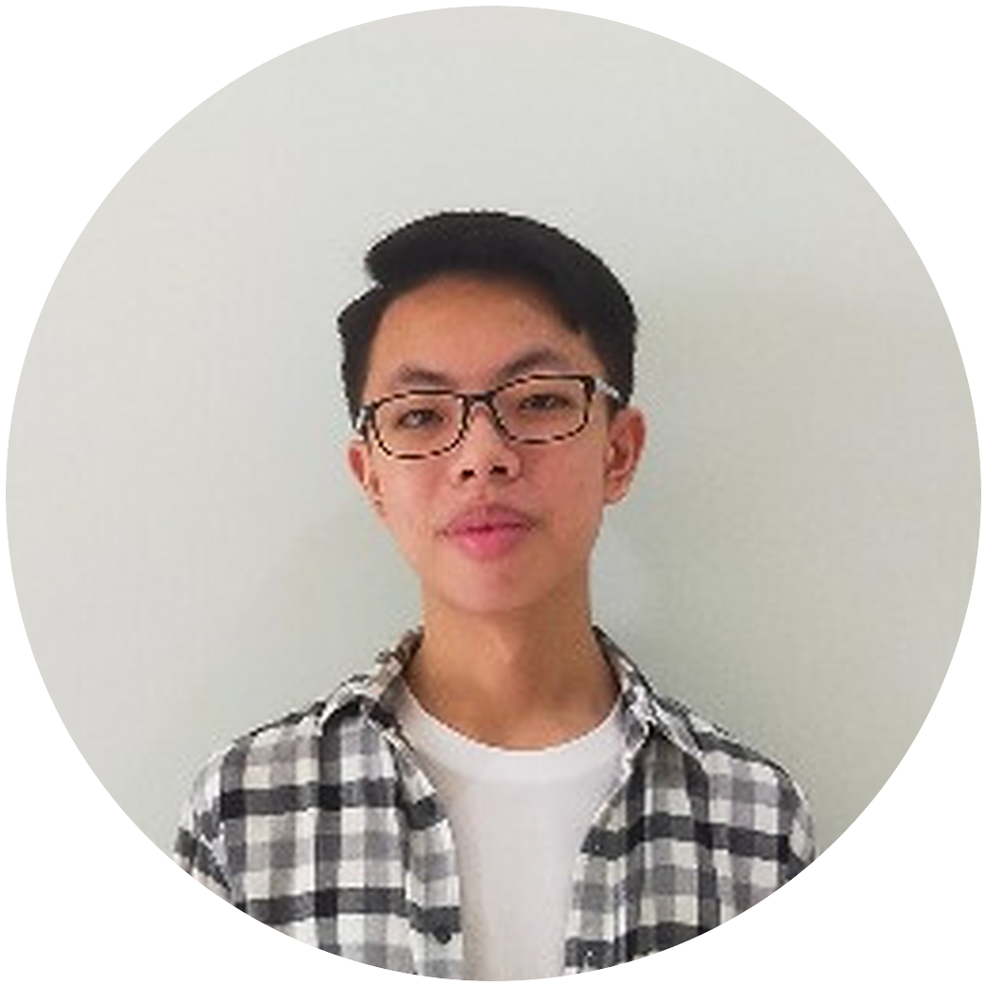
Amadeus Eugene
Dirgantara
Informatics student, AI focus
Universitas Ciputra
Notes:
START. Jump start: Meet the people. Then Who and Why.
Smile. 'Good morning, everyone. Thank you for being here.'
'My name is Amadeus Eugene Dirgantara. I am a fifth-semester Informatics student at Universitas Ciputra, and my focus is AI.'
'I am here to introduce myself.'
'By the end, you will know who I am and what kind of work I do.'

Slide 2
01
My background
02
Things I have built
03
My plans
Notes:
START. What and How, then the first signpost.
'I will cover three points: my background, some things I have built, and my plans.'
'This will take about six minutes. Please keep your questions until the end.'
'Let me start with my first point, my background.'

Slide 3
I work in software.
Websites, phone apps
and small devices.
Informatics, AI focus · Universitas Ciputra · 5th semester
Notes:
POINT 1, definition.
'I work in software. That means I build programs that people use, such as websites, phone apps and small devices.'

Slide 4
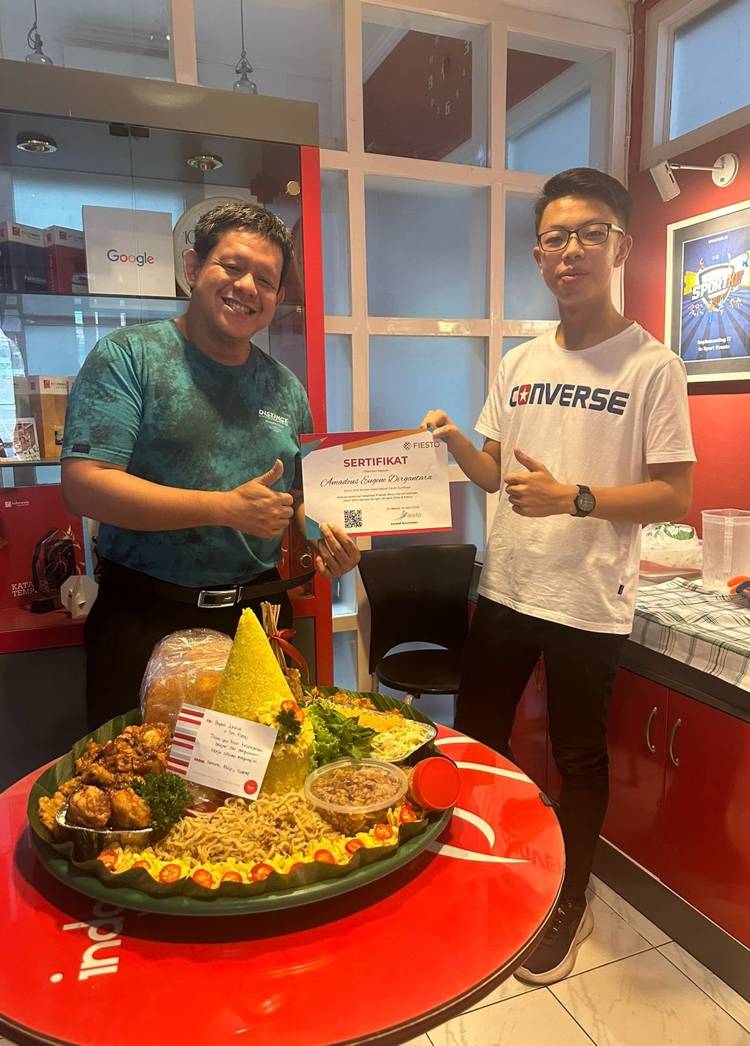
My background
2019 to 2023
freelance projects online, mostly apps and websites
2024
ticketing website for my high school's arts festival
April 2024
internship at Fiesto Informatika, Surabaya
2024 to 2025
wrote problems for NPLC, a programming competition
Notes:
POINT 1, examples and facts. One line at a time, top to bottom. The photo is the last day of the internship.
'I started in junior high school. From 2019 to 2023 I did freelance projects online, mostly apps and websites, for clients in other countries.'
'In 2024 I built the ticketing website for my high school's arts festival. It showed which seats were free and recorded the orders. It was used to sell tickets during the event.'
'In April 2024 I did an internship at Fiesto Informatika in Surabaya. For four weeks I worked with the team on client websites.'
'At university, I wrote and tested problems for NPLC, a programming competition, in 2024 and 2025.'
Signpost: 'Moving on to my second point: some things I have built.'

Slide 5
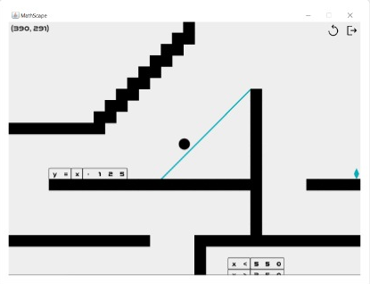
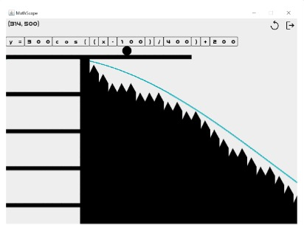
MathScape
2025 · game · first-semester course project
Notes:
POINT 2, definition, then example 1.
'I work on different kinds of software. I will show four examples.'
'The first is MathScape, a game I made in my first semester. The player writes a math equation, and its graph becomes the ground to walk on. It has ten levels.'

Slide 6
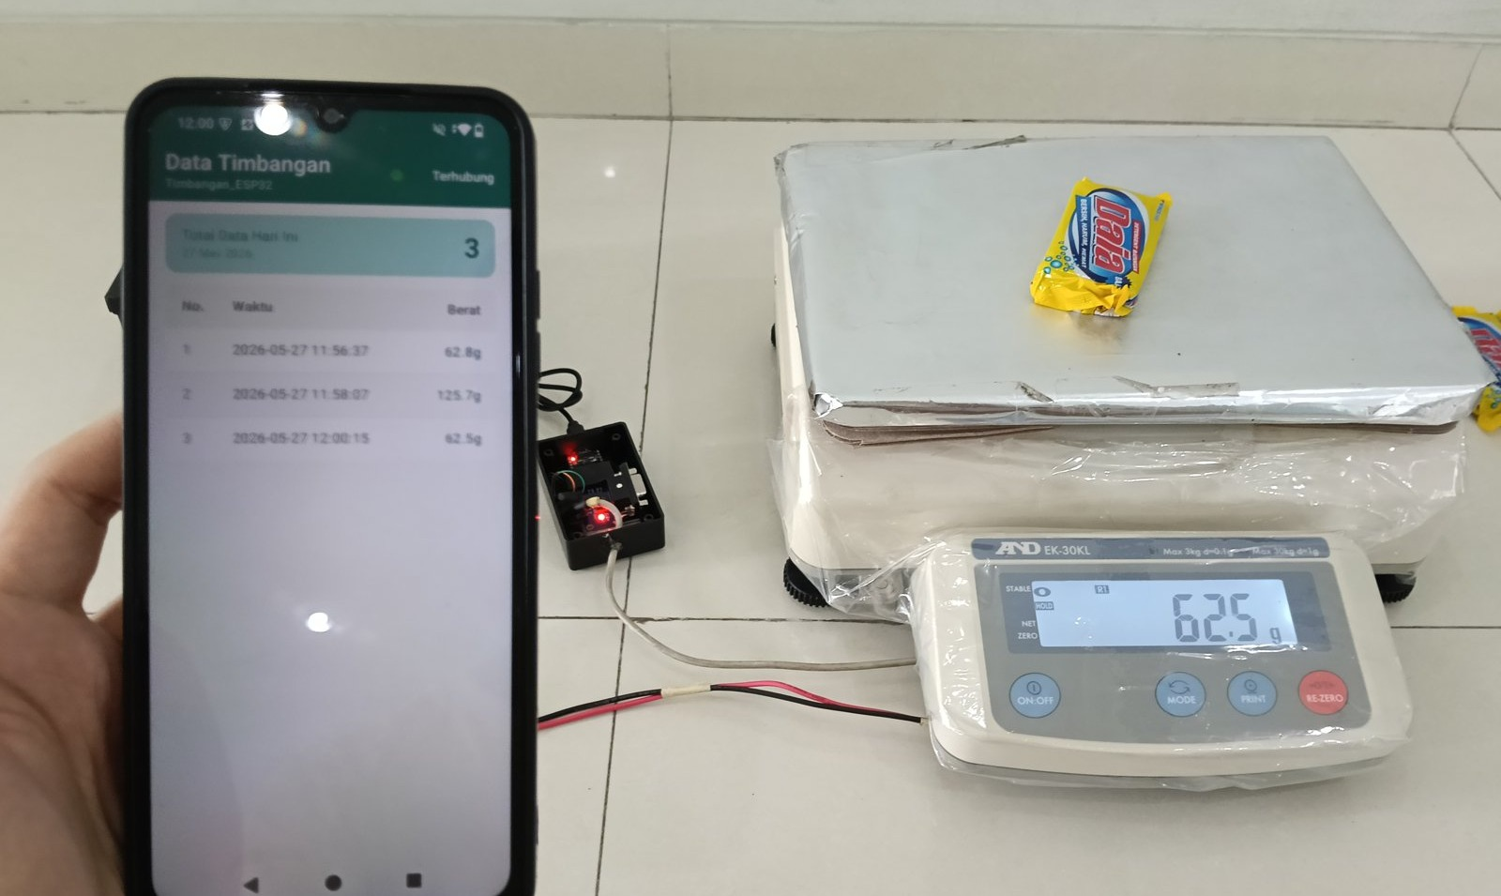
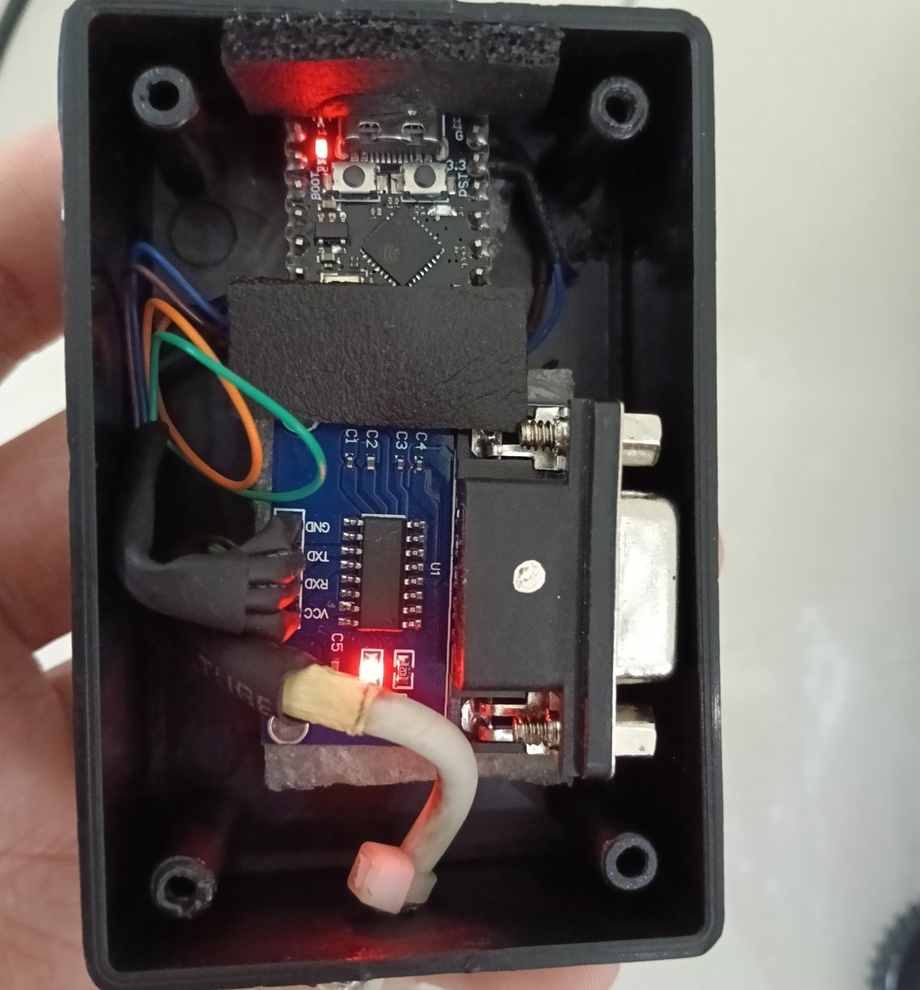
Weighing data logger
2026 · device and Android app · freelance job
Notes:
POINT 2, example 2. Point at the scale, the phone, then the device.
'The second is a weighing data logger, a freelance job from this year. The client weighs goods outdoors with an industrial scale. The scale's own logger saves to a memory card, so someone has to carry the card to a computer.'
'I built a small device that sends each weight to a phone, and an app that saves it to a file. I tested it on the real scale, and the client uses it now.'

Slide 7
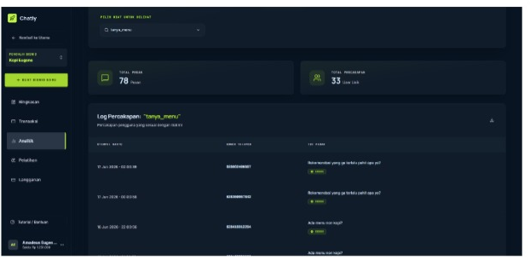
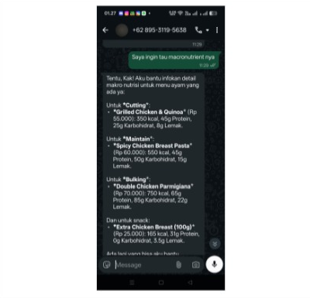
Chatly
2026 · WhatsApp chatbot · class project, team of 8
Notes:
POINT 2, example 3. Left is what the business owner sees. Right is a real chat with a customer.
'The third is Chatly, a class project from this year. We were a team of eight, and I was one of two developers. It is a chatbot inside WhatsApp. A business uploads what it sells, and the bot answers its customers. It is online now.'

Slide 8
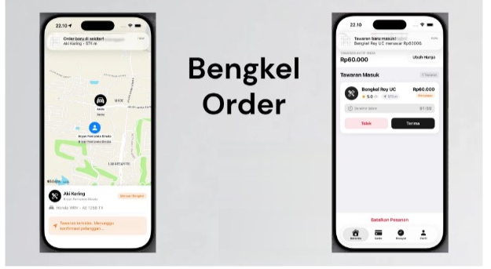
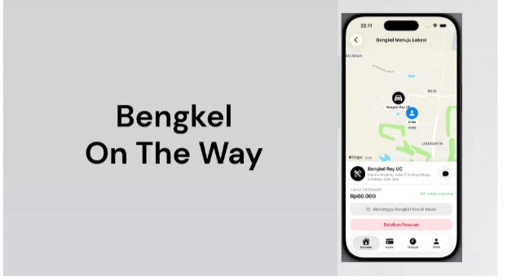
Bengkelin
2026 · iPhone app · class project, team of 4
Notes:
POINT 2, example 4, then how you work.
'The fourth is Bengkelin, also a class project, in a team of four. I built the iPhone app. A driver whose car has broken down sends a request, nearby workshops offer a price, and the driver chooses one.'
'Each of these needed something I had not used before, so I learned it. I plan the structure first, and then I work step by step.'
Signpost: 'That brings me to the last point of my presentation: my plans.'

Slide 9
My plans
NOW
NEXT
GOAL
Informatics student, AI focus
Apple Developer Academy, 2027
Software engineer
Notes:
POINT 3: definition, fact, example.
'My goal is to work as a software engineer. That means building software as my job, as part of a team.'
'Right now I am still studying, and my focus is AI.'
'My next step is the Apple Developer Academy. I will join it in 2027.'
'It is a program by Apple that trains app developers.'

Slide 10
Thank you.
Questions are welcome.
amadeuseugenedirgantara@gmail.com
linkedin.com/in/amadeus-dirgantara-364aa2385
Notes:
FINISH. The lecturer's Finish (signal, summary, conclusion, closing remarks) has not been written yet.
Plain close for now: 'That is my introduction. Thank you. I am happy to answer your questions.'

