Slide 1
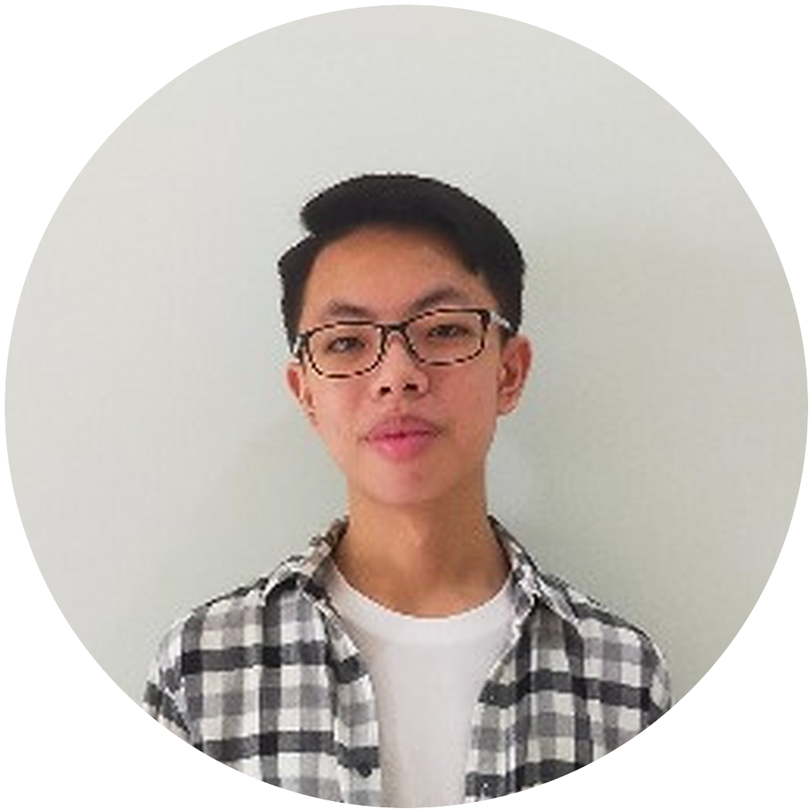
AFL 1 · SELF-BRANDING
Amadeus Eugene
Dirgantara
Informatics student · AI and software development
Universitas Ciputra
Notes:
Walk up smiling. Stand still, feet apart, look at the audience (stage presence).
Say nothing yet. Pause two seconds, then go to the next slide.
Prop for the finish: put the logger device on the desk now, closed, without explaining it.

Slide 2
How does a project go
from an idea to something people use?
Five minutes. I will answer it with my own projects.
Notes:
JUMP START: Question and Answer (W2). Ask it, then answer it yourself in the next slides.
Say: 'How does a project go from an idea to something people use? I will answer that with my own projects.'
WIIFM: you will see two real projects and how each one was built. Look at the audience, not the screen.

Slide 3
WHO
Amadeus, Informatics student, AI specialization
WHY
To introduce myself and my work
WHAT
My background, my projects, my plans
HOW
Five minutes. Questions at the end
Notes:
START (W1): Who, Why, What, How. One sentence each, spoken, not read.
Who: 'I am Amadeus, an Informatics student specializing in AI.'
Why: to introduce yourself and your work. What: background, projects, plans. How: five minutes, questions at the end.
Signpost: 'Let me start with my first point.'

Slide 4
1 · WHO I AM
Professionally, I am someone who
develops software,
especially web, mobile and small devices.
Informatics, AI specialization · Universitas Ciputra
CGPA 3.89 / 4.00
Notes:
30-second identity statement (W1). Spoken, not read: 'Professionally, I am someone who develops software, especially web, mobile and small devices.'
Then one fact: Informatics, AI specialization, CGPA 3.89.
Signpost: 'Moving on to my second point: my projects and experience.'

Slide 5
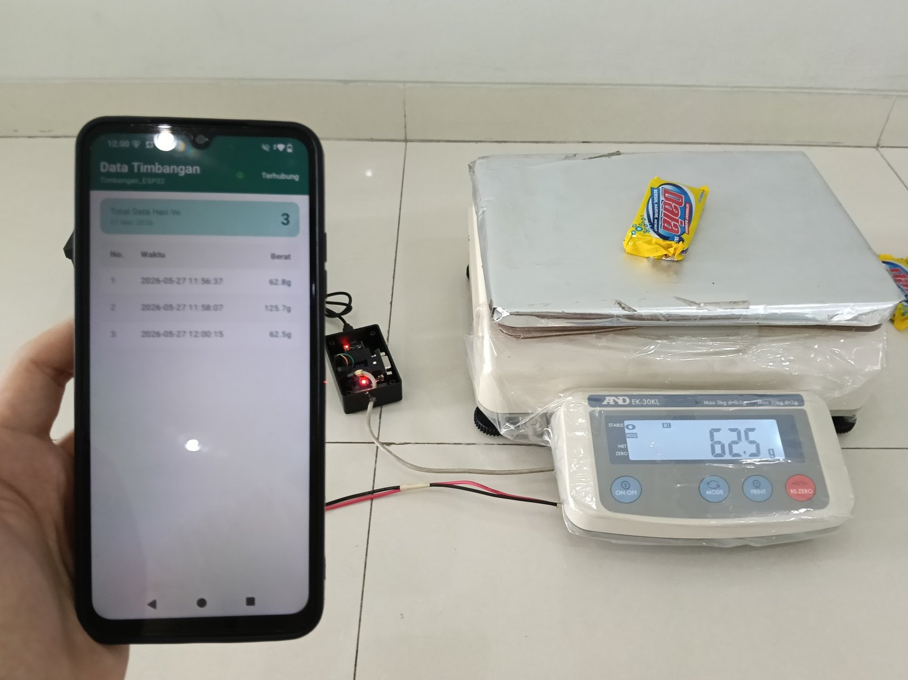
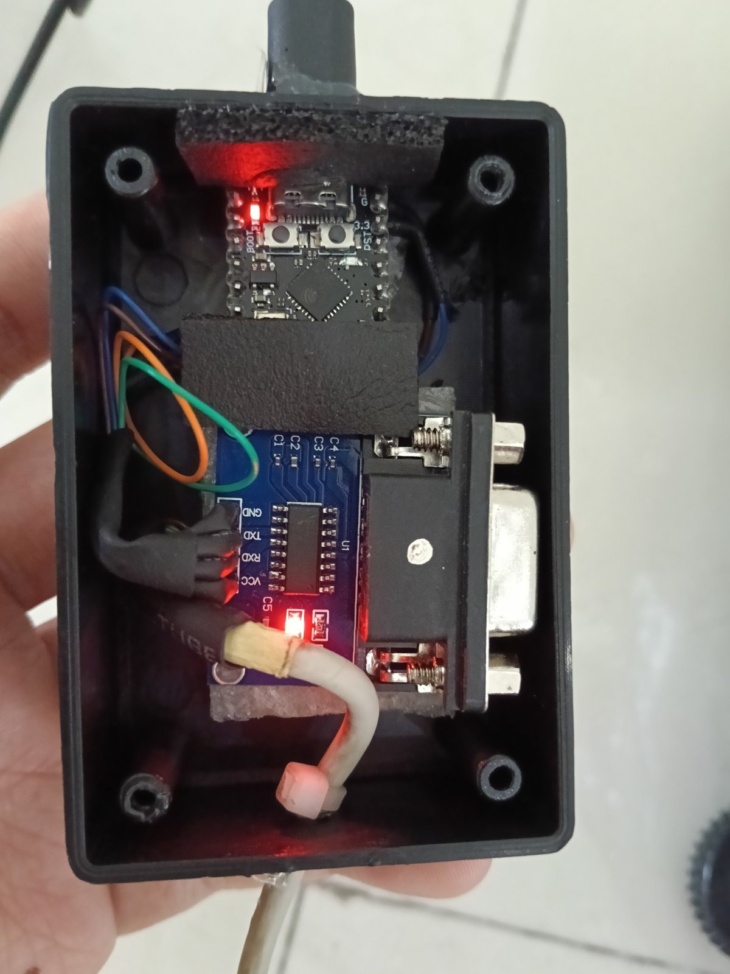
2 · PROJECTS AND EXPERIENCE
Project 1: a weighing data logger
Device
a small circuit board in a custom case
Connection
reads the scale and sends the weight by Bluetooth
Android app
records every weighing
A lower-cost alternative to the scale maker's accessory. In daily use.
Notes:
Commissioned freelance project, 2026. Hold up the real device here if you brought it.
Say: 'A client needed to record the weight from an A&D EK-30KL scale. The scale maker sells an accessory for this, so I built a lower-cost alternative.'
Point at the photos: the circuit board, the scale, the app. Keep your hands natural and purposeful (delivery).
Do not read the slide. One sentence: 'It is in daily use now.'

Slide 6
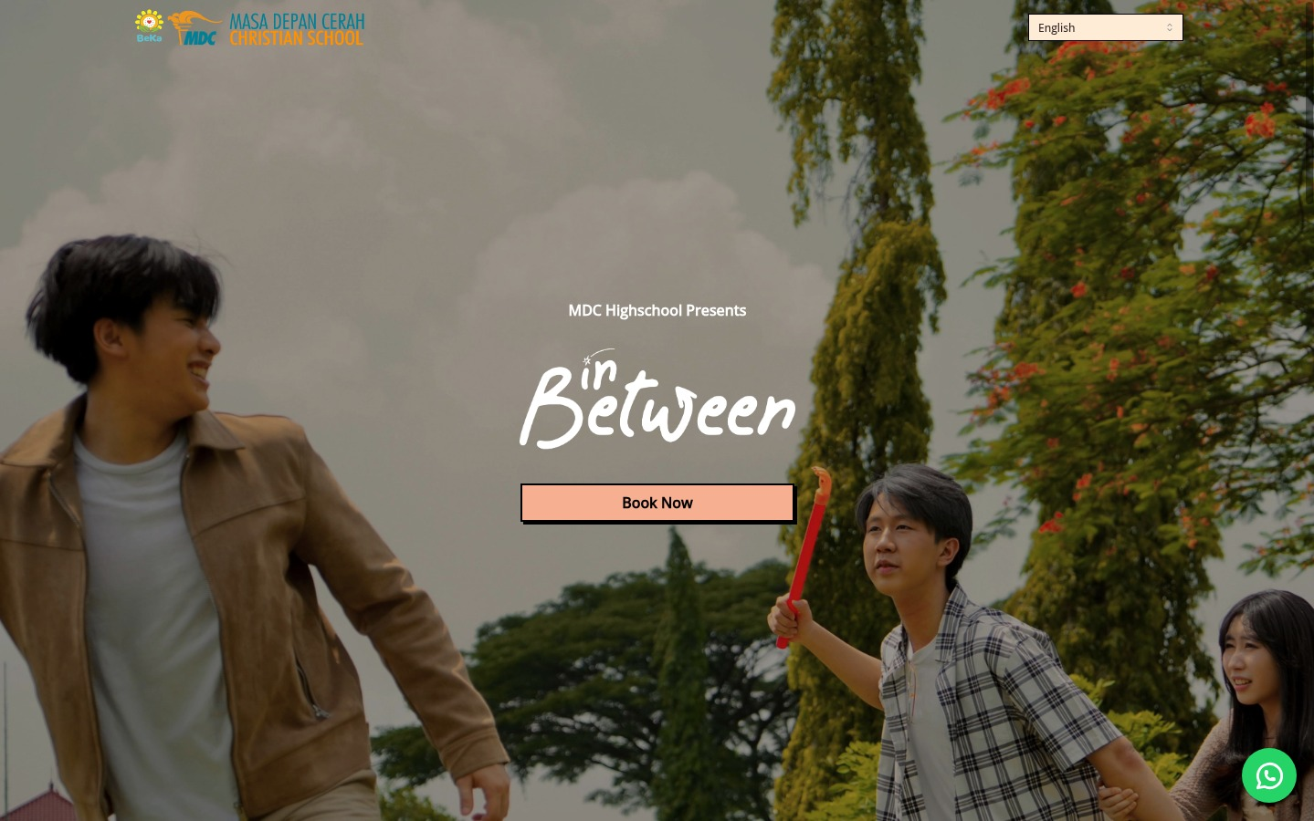
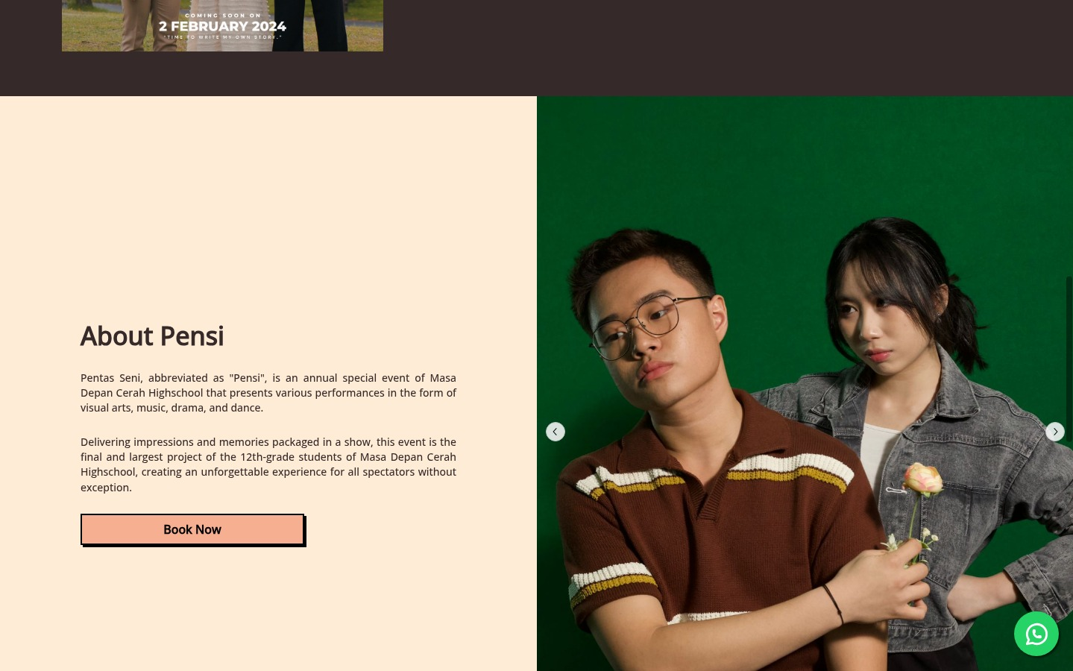
2 · PROJECTS AND EXPERIENCE
Project 2: a ticketing website
Pensi 2024, MDC Senior High School · shows seat availability and records every order.
Notes:
Pensi 2024, school arts festival, MDC Senior High School. You built it end to end.
Say: 'I built the website and its server side. It showed which seats were free and recorded every order. It was used for live ticket sales during the event.'
Signpost: 'Next, my other experience.' Keep eye contact, then advance.

Slide 7
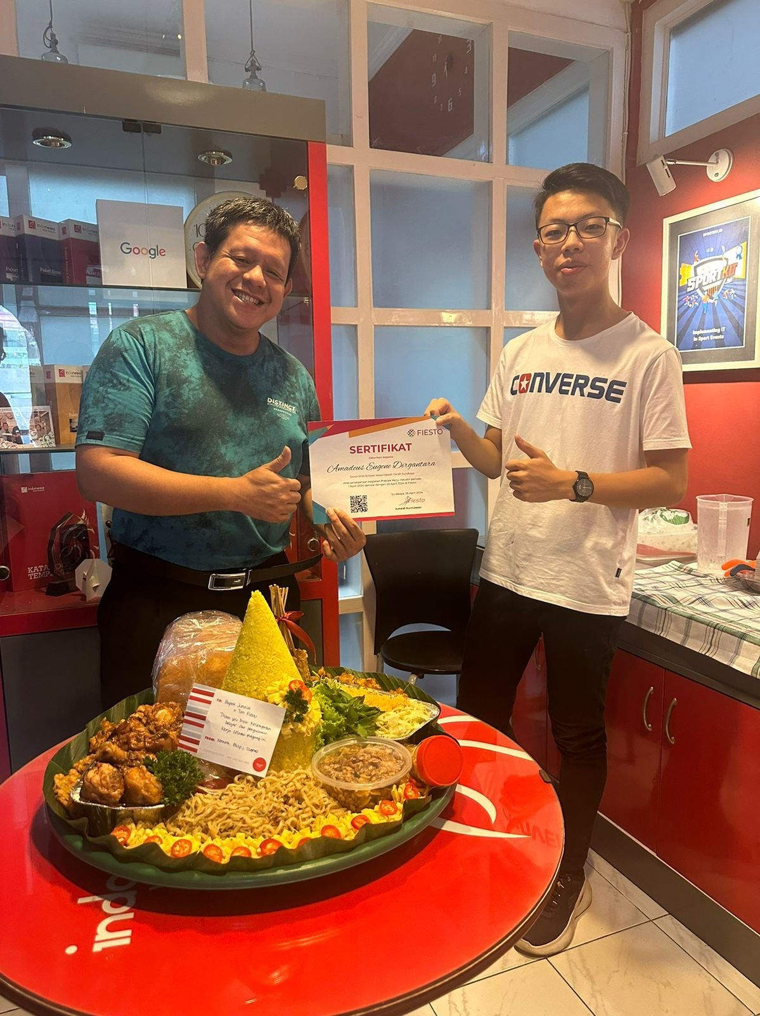
2 · PROJECTS AND EXPERIENCE
Other experience
2019 to 2023
freelance web and software projects for clients worldwide
April 2024
web development intern, CV Fiesto Informatika Indonesia
2024 to 2025
problem setter, NPLC programming competition
Notes:
Photo: the internship certificate handover at Fiesto, April 2024.
Three facts, one breath each: freelance work from 2019 to 2023, the Fiesto internship, and writing problems for the NPLC competition.
Signpost: 'That brings me to my last point: where I am heading.'

Slide 8
3 · WHERE I AM HEADING
My plan
NOW
NEXT
GOAL
Informatics student, AI specialization.
Study machine learning and use it in practical projects.
Work as an AI or software engineer.
Notes:
What you want to be. Say it as a plan: now, next, goal.
Edit this slide to match the role and field you really want before the final.
Signpost: 'To finish...' (this is your SIGNAL for the closing).

Slide 9
In summary
01
02
03
Student: Informatics, AI
Projects: web, mobile, devices
Next: machine learning
Notes:
FINISH: SIGNAL, SUMMARY. 'To finish, a short summary.'
One sentence per point: I study Informatics with an AI focus. I have worked on web, mobile and device projects. Next, I want to apply machine learning in practice.

Slide 10
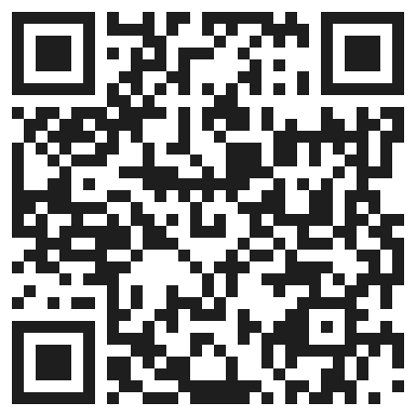
From idea to use, in my experience:
Understand the need.
Build it step by step.
Test it with real users.
SCAN TO CONNECT
amadeuseugenedirgantara@gmail.com
linkedin.com/in/amadeus-dirgantara-364aa2385
Instagram @aeugene.d
Thank you.
Notes:
FINISH WITH A BANG (W3): circle back to the opening question, then use the prop.
Say: 'At the start I asked how a project goes from an idea to something people use. In my experience: understand the need, build it step by step, and test it with real users.'
Pick up the closed logger from the desk: 'And this is the box I did not explain at the start.' (W3, sample 1: the box.)
CONCLUSION and CLOSING REMARKS: 'Thank you. Please scan to connect.' Then take questions.

